Slide 1
Information and Network Security
Name: Kanan Bhatt
En No:170210107006
Topic: Cryptography, Cryptanalysis and Attacks

Slide 2
Cryptography
Human being from ages had two characteristic needs: (a) to communicate and share information and (b) to communicate selectively. These two needs gave rise to the art of coding the messages in such a way that only the intended people could have access to the information. Unauthorized people could not extract any information. The art and science of hiding the messages to introduce secrecy in information security is recognized as cryptography. The word ‘cryptography’ was created by combining two Greek words, ‘Krypto’ meaning hidden and ‘graphene’ meaning writing.
Cryptography is the art and science of making a cryptosystem that is capable of providing information security. Cryptography deals with the actual securing of digital data. It refers to the design of mechanisms based on mathematical algorithms that provide fundamental information security services.

Slide 3
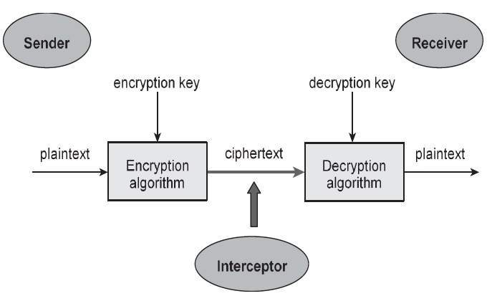
Cryptography involves creating written or generated codes that allow information to be kept secret. Cryptography converts data into a format that is unreadable for an unauthorized user, allowing it to be transmitted without unauthorized entities decoding it back into a readable format, thus compromising the data.
Information security uses cryptography on several levels. The information cannot be read without a key to decrypt it. The information maintains its integrity during transit and while being stored. Cryptography also helps in nonrepudiation. This means that the sender and the delivery of a message can be verified.

Slide 4
Cryptanalysis
The art and science of breaking the cipher text without knowing a key is known as cryptanalysis. Cryptanalysis is the sister branch of cryptography and they both co-exist. The cryptographic process results in the cipher text for transmission or storage. It involves the study of cryptographic mechanism with the intention to break them. Cryptanalysis is also used during the design of the new cryptographic techniques to test their security strengths.
Un-readable Format
Readable Format
Cryptanalysis

Slide 5
 | Cryptography | Cryptanalysis
Defintion | The art or science of encrypting plain messages into cipher text for security of the messages especially while transmission. | The art of obtaining plain text from a cipher text without knowledge of key
Focus | Secret writing | Breaking secrets
Concern for cipher or hash | Obtaining an original or completely new hash. | Hash or cypher needs to be more conservative and therefore slower
Characteristics | It uses operations like substitution, transposition and product systems The system may use same key or different keys for sender and receiver Processing techniques include block cipher and stream cipher | Depends on the nature of the algorithm and mostly at some knowledge of the characteristics of plaintext It attempts to find out the ciphertext or the key

Slide 6
Cryptanalytic Attacks
Ciphertext-only attack: In this attack the attacker knows only the ciphertext to be decoded. The attacker will try to find the key or decrypt one or more pieces of ciphertext (only relatively weak algorithms fail to withstand a ciphertext-only attack).
Known plaintext attack: The attacker has a collection of plaintext-ciphertext pairs and is trying to find the key or to decrypt some other ciphertext that has been encrypted with the same key.
Chosen Plaintext attack: This is a known plaintext attack in which the attacker can choose the plaintext to be encrypted and read the corresponding ciphertext.

Slide 7
Chosen Ciphertext attack: The attacker has the able to select any ciphertext and study the plaintext produced by decrypting them.
Chosen text attack: The attacker has the abilities required in the previous two attacks.
References:
https://www.tutorialspoint.com/cryptography/cryptography_tutorial.pdf
http://www.differencebetween.info/difference-between-cryptography-and-cryptanalysis
www.infosectrain.com
Thank You

